Slide 1



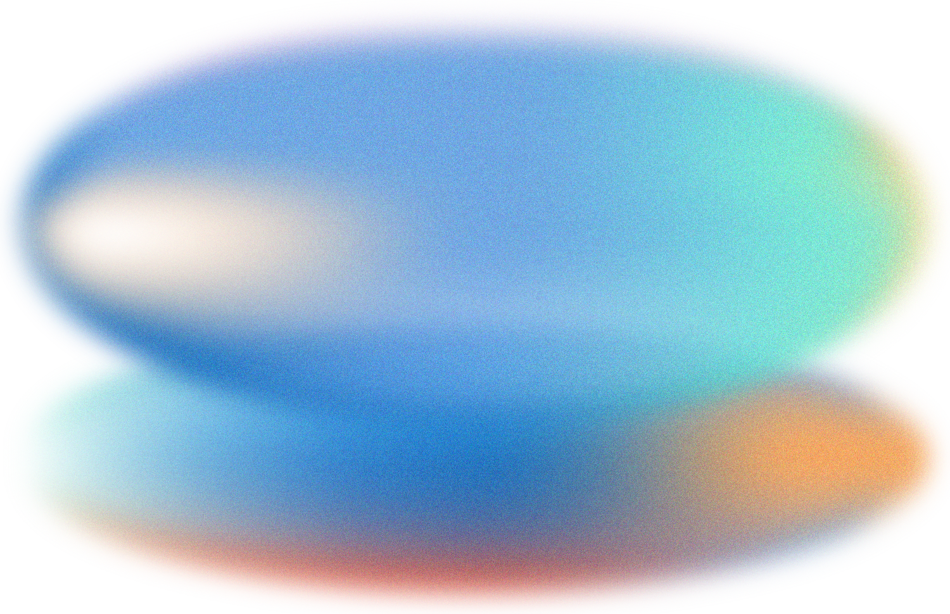

AI SMART MIRROR FOR SKIN ANALYSIS
TEAM MEMBERS
MENTOR
MEHARNISHA M (23619219)
ABDUL ALAGAN (23619201) GAYISHA RAJESH (23619207)
MS.SOWMIYA SM
(Assistant Professor,VISTAS)
Department of AIML
DEPARTMENT OF ARTIFICIAL INTELLIGENCE AND MACHINE LEARNING

Slide 2

PROBLEM STATEMENT
    Skin conditions such as acne, dark spots, and redness are common and can be difficult to monitor regularly.
    Professional skin analysis systems can be expensive and inaccessible for students and general users.
    Existing AI-based skin analysis systems often require high computational resources or complex hardware.
    There is a need for a low-cost, simple, and user-friendly system that can perform basic skin-condition analysis.
    The proposed system uses Artificial Intelligence, Computer Vision, and Raspberry Pi to provide basic skin-condition detection through a smart mirror.
Proposed Solution
Develop a low-cost AI Smart Mirror that captures a user's facial image, identifies basic skin conditions using a lightweight deep-learning model, and displays the result with simple skincare guidance.

Slide 3


OBJECTIVE
  To develop a low-cost AI-based smart mirror using Raspberry Pi 4.
  To capture facial images using a camera module.
  To classify basic skin conditions into four categories:
  Normal Skin
  Acne
  Dark Spots
  Redness
  To use a lightweight MobileNetV2-based deep learning model suitable for Raspberry Pi deployment.
  To display the detected condition and confidence score on the mirror.
  To provide basic skincare recommendations based on the detected condition.

Slide 4
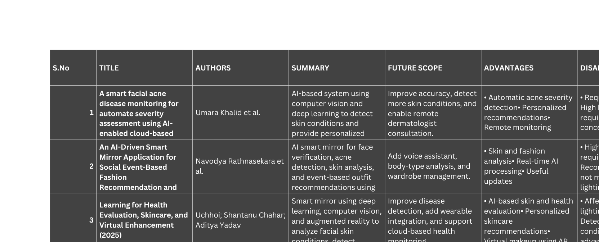
LITERATURE SURVEY

Slide 5
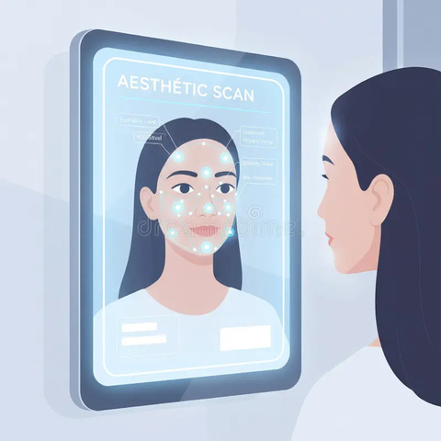
PROPOSED SYSTEM
The proposed system is a low-cost AI Smart Mirror that uses a camera to capture the user's facial image and a MobileNetV2-based deep-learning model to classify the skin into four categories: Normal Skin, Acne, Dark Spots, and Redness. The Raspberry Pi processes the image and displays the detected condition, confidence score, and basic skincare recommendation on the smart mirror.
AI-Based Skin Classification: The image is preprocessed and analyzed using a lightweight MobileNetV2 model to identify Normal Skin, Acne, Dark Spots, or Redness.
02
Facial Image Capture: A camera connected to the Raspberry Pi 4 captures the user's facial image in real time.
01
Smart Mirror Display: The prediction and recommendation are displayed on the smart mirror interface, providing a simple and user-friendly experience.
Result & Recommendation: The system generates the detected skin condition along with a confidence score and basic skincare recommendation.
04
03

Slide 6
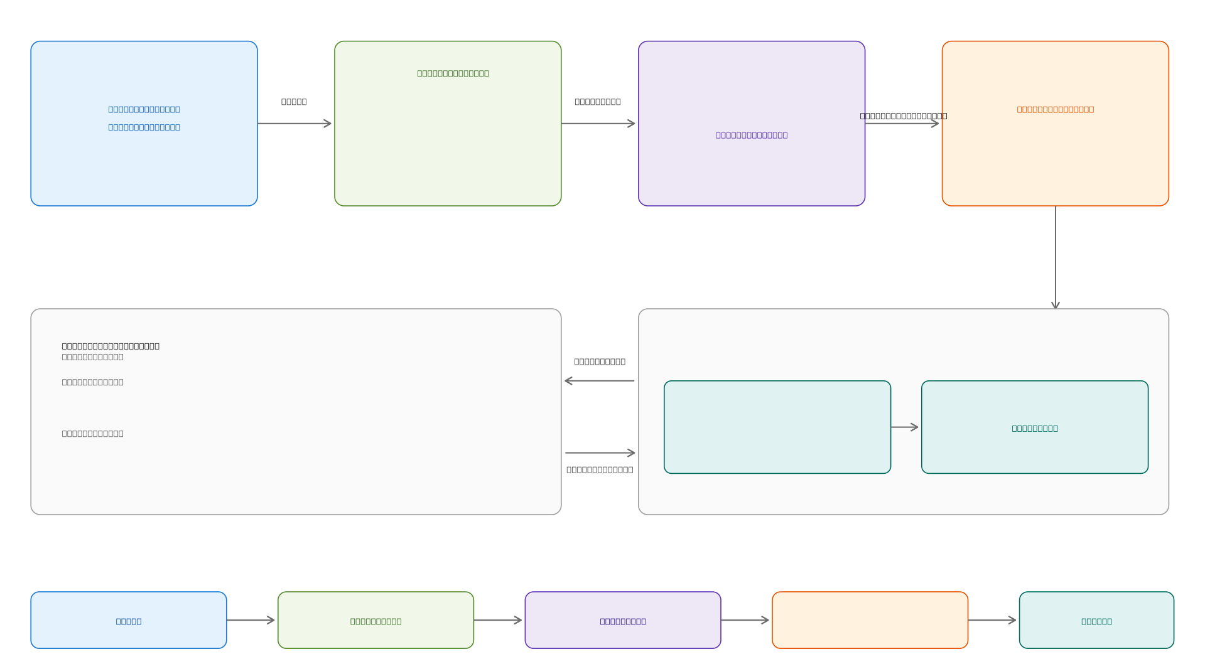
SYSTEM ARCHITECTURE

Slide 7
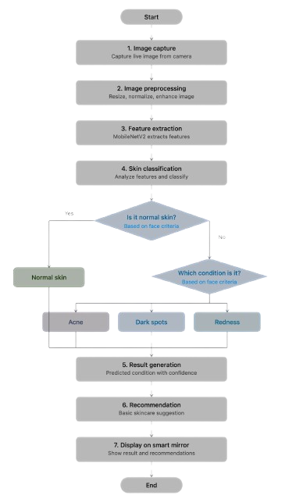
FLOW DIAGRAM

Slide 8
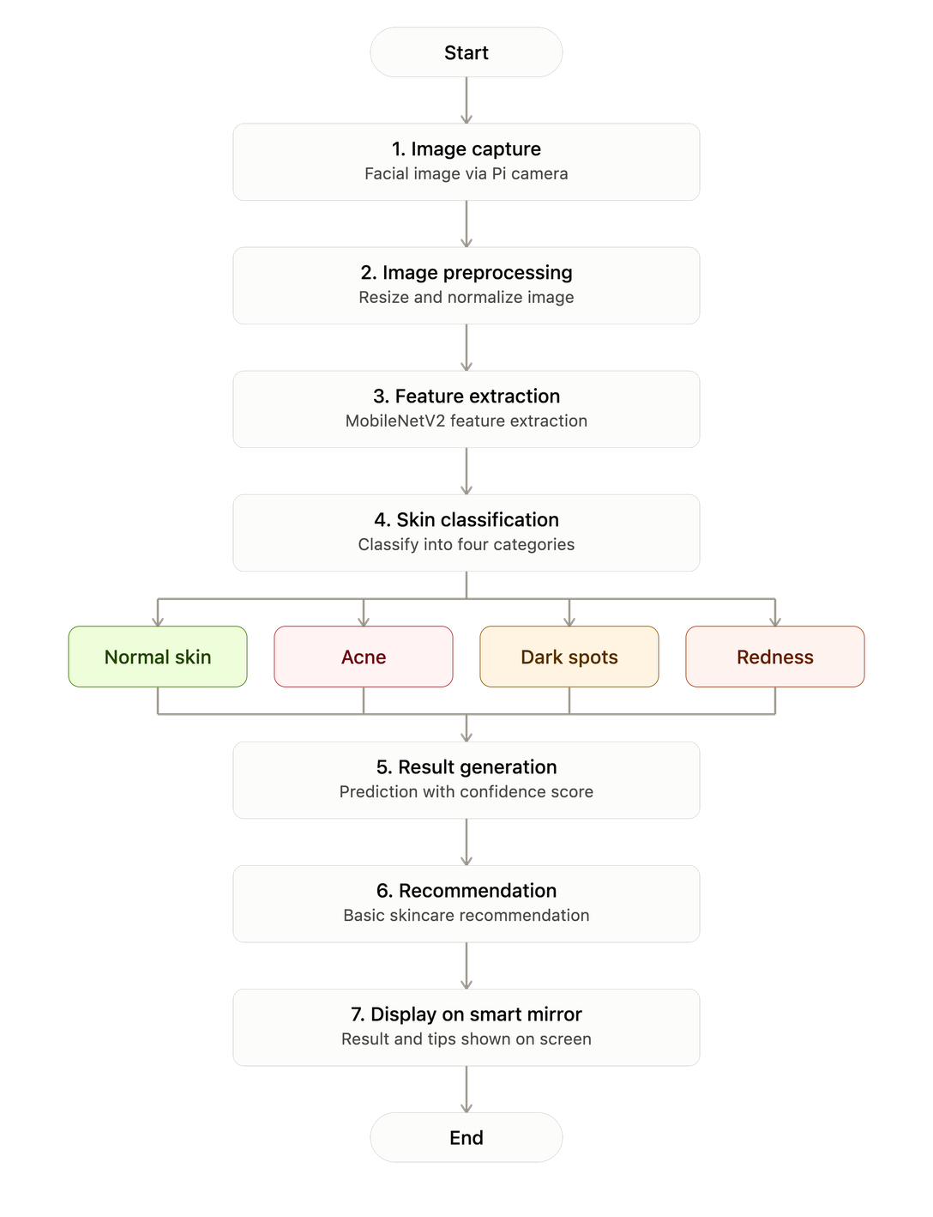
FLOW CHART

Slide 9
Module 1: Hardware & Image Acquisition
Module
Main Activities
Progress
Raspberry Pi 4 setup, camera connection, display setup, and capturing facial images
Module 1: Hardware & Image Acquisition
✅ Hardware and image acquisition has been completed

Slide 10
Module 2: Dataset & Image Preprocessing
Module
Main Activities
Progress
Dataset collection, classification into 4 categories, image resizing and normalization
Module 2: Dataset & Image Preprocessing
Implementation of this module is currently in progress.

Slide 11
Module 3: AI Model Development
Module
Main Activities
Progress
MobileNetV2-based model training for Normal Skin, Acne, Dark Spots and Redness
Module 3: AI Model Development
Implementation of this module is currently in progress.

Slide 12
Module 4: Model Deployment & Recommendation
Module
Main Activities
Progress
TensorFlow Lite conversion, Raspberry Pi deployment, prediction and skincare recommendation
Module 4: Model Deployment & Recommendation
Implementation of this module is yet to be started.

Slide 13
Module 5: Smart Mirror Integration & Testing
Module
Main Activities
Progress
Display prediction, confidence score and recommendation; complete system integration and testing
Module 5: Smart Mirror Integration & Testing
Implementation of this module is yet to be started.

Slide 14
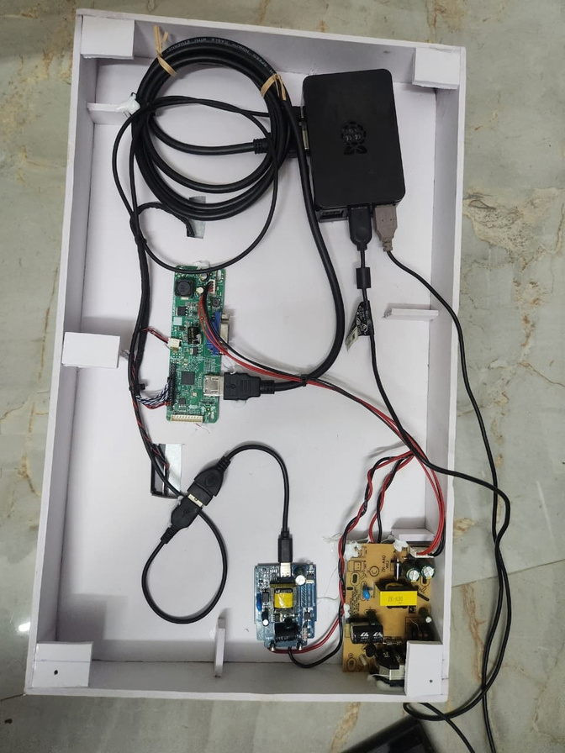
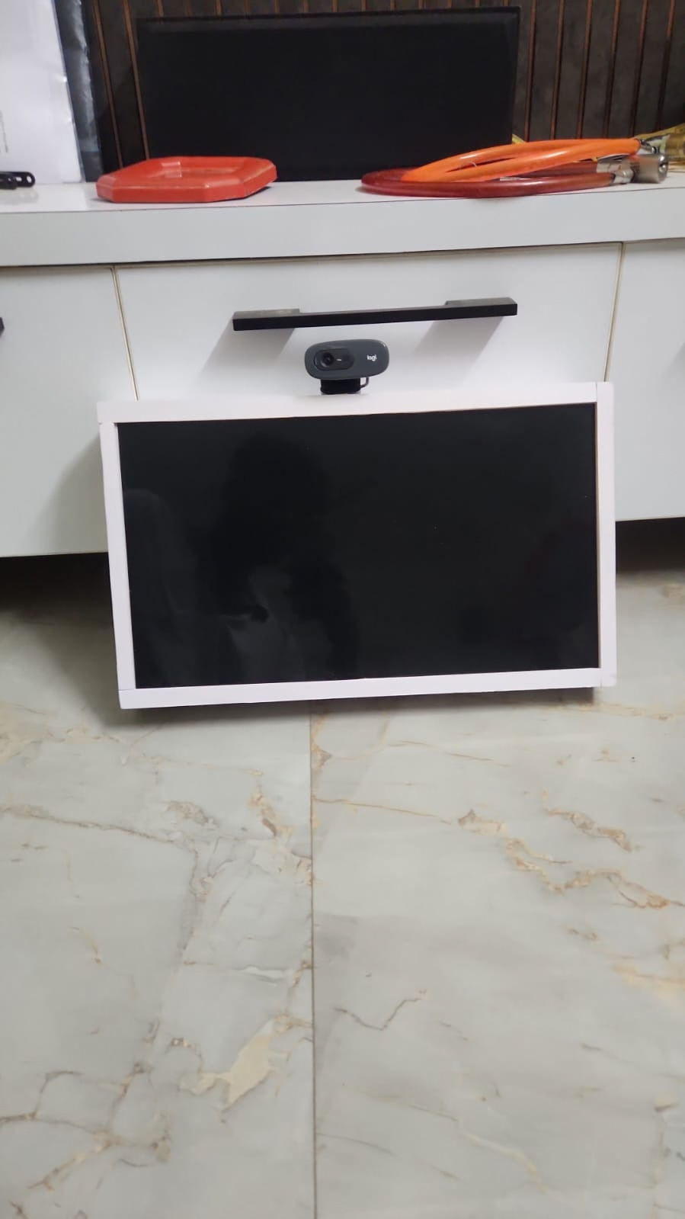
IMPLEMENTATION

Slide 15
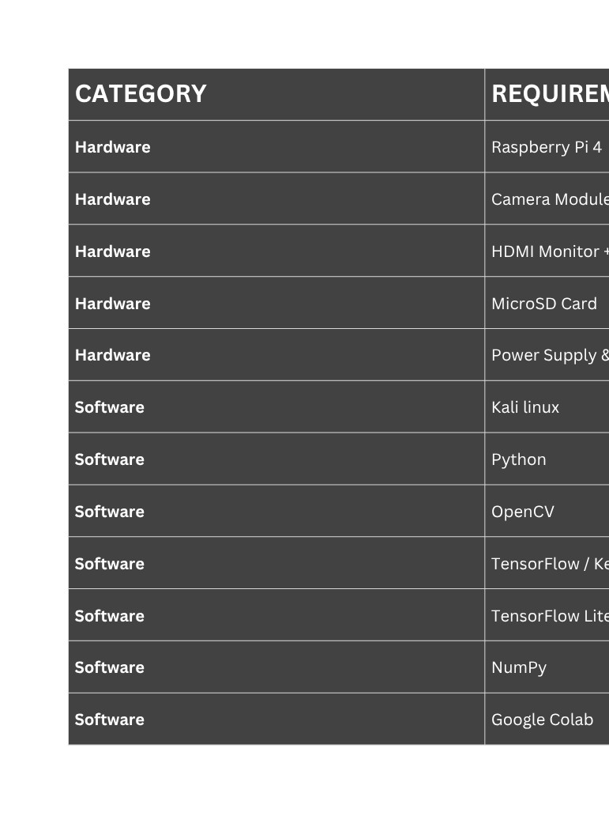
HARDWARE AND SOFTWARE REQUIREMENTS

Slide 16
RESULTS AND DISCUSSIONS
  The Raspberry Pi 4 and camera module have been successfully set up for facial image acquisition.
  The system is being developed to classify facial skin into Normal Skin, Acne, Dark Spots, and Redness using MobileNetV2.
  Dataset preparation and image preprocessing are currently in progress to prepare suitable inputs for model training.
  MobileNetV2 model development and training are currently in progress, with model evaluation planned after training.
  The final system will display the detected skin condition, confidence score, and basic skincare recommendation through the smart mirror.

Slide 17
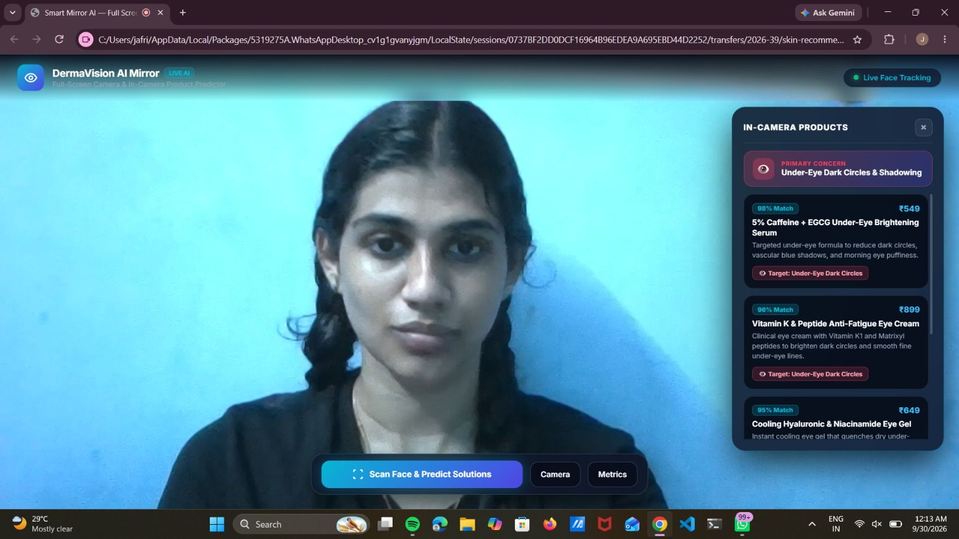
OUTPUT:

Slide 18
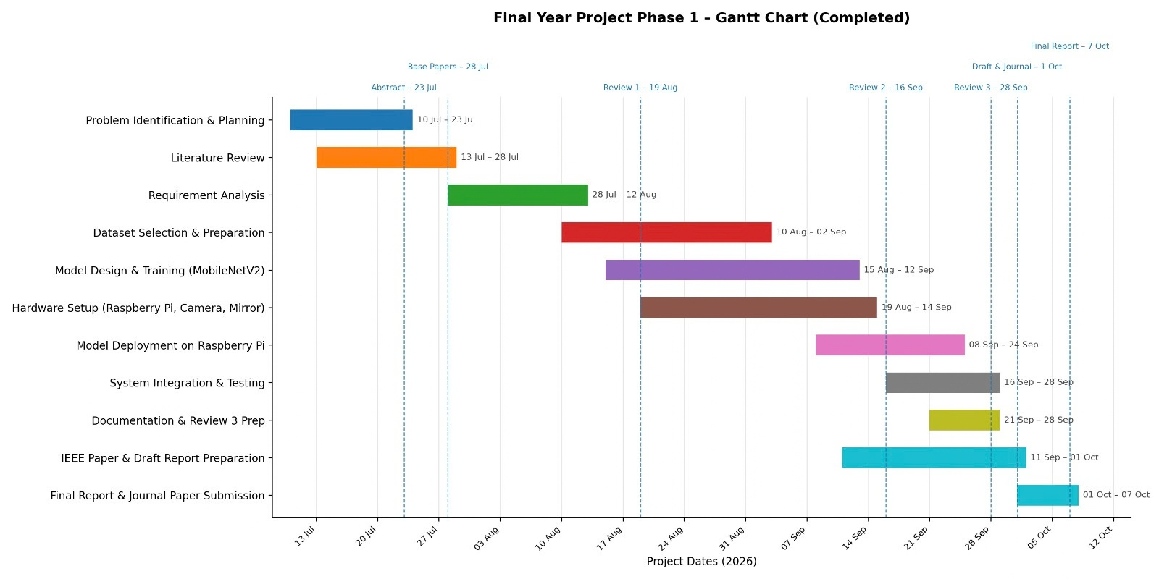

GANTT CHART

Slide 19



CHALLENGES FACED
  Collecting a suitable and balanced dataset for all four skin-condition categories.
  Variations in lighting and image quality can affect the accuracy of skin-condition detection.
  Training a lightweight model while maintaining good classification performance.
  Running AI processing efficiently on Raspberry Pi 4 due to its limited computational resources.
  Integrating the camera, AI model, Raspberry Pi, and display for real-time operation.

Slide 20
FUTURE WORK
  The system can be improved to achieve higher accuracy in skin-condition detection.
  More skin conditions can be included in the classification system in the future.
  A larger and more diverse dataset can be used to improve model performance.
  The system can provide more personalized skincare recommendations based on the detected condition.
  Future versions can support long-term monitoring of skin-condition changes.
  The smart mirror can be further optimized for faster real-time analysis.

Slide 21
REFERENCES
  Umara Khalid Li Chen, Abdullah Ayub Khan BoweI Chen, Faisal Mehmood, Muhammad Yasir, “A Smart Facial Acne Disease Monitoring for Automatic Severity Assessment Using AI-Enabled Cloud-Based Internet of Things,” 2025.
  Navodya Rathnasekara, Nisala Damith, Dasuni Herath, Sanuri Himalkа Liyanaarachchi, Ovini Visna Seneviratne, Udaya Wijenayake, “An AI-Driven Smart Mirror Application for Social Event-Based Fashion Recommendation and Facial Skin Health Analysis,” 2025.
  Uchoi, Shantanu Chahar, Aditya Yadav, “Deep Learning for Health Evaluation, Skincare, and Virtual Enhancement,” 2025.
  Kiran M K, Kusum Meda Ravi, Umadevi V, “Smart Mirror Based Health Monitoring System Using Deep Learning,” 2025.
  Jinhee Lee MS, Huisu Yoon PhD, Semin Kim PhD, Chanhyeok Lee MS, Jongha Lee MS, Sangwook Yoo PhD, “Deep Learning-Based Skin Care Product Recommendation: A Focus on Cosmetic Ingredient Analysis and Facial Skin Conditions,” 2025.

Slide 22
Thank You

